Slide 1
Smart Room System
Smart way to enlighten the world
Dr. Asim Imdad Wagan
Spring 2019
Muhammad Ali Jinnah University

Slide 2
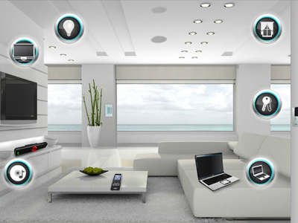
Project Overview
Smart Room System is a smart way to deal with home appliances. Idea, since the beginning, based on the development of a system that does not only facilitate but also contains the smart look. Now it is easy to deal with all the appliances as they are on your finger tips

Slide 3
A Glance on outlook
Contains the Buttons and Images, Carefully placed every cell in order

Slide 4
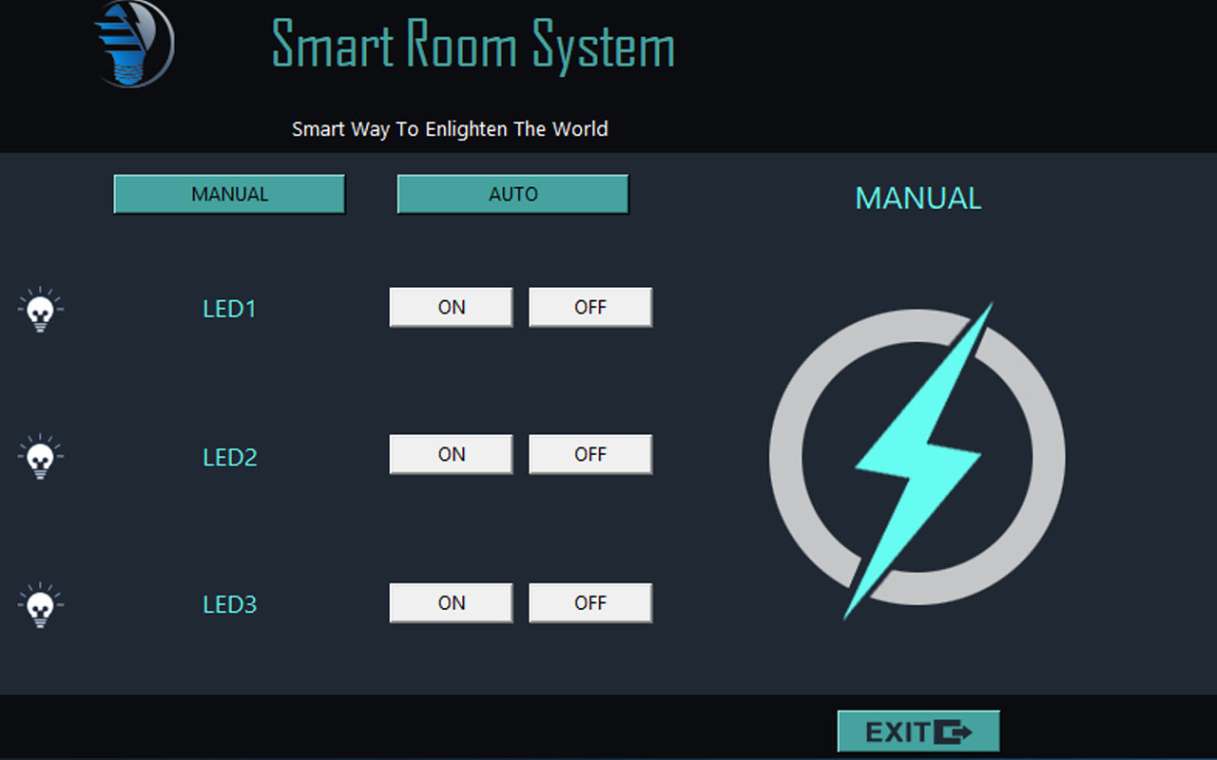

Slide 5
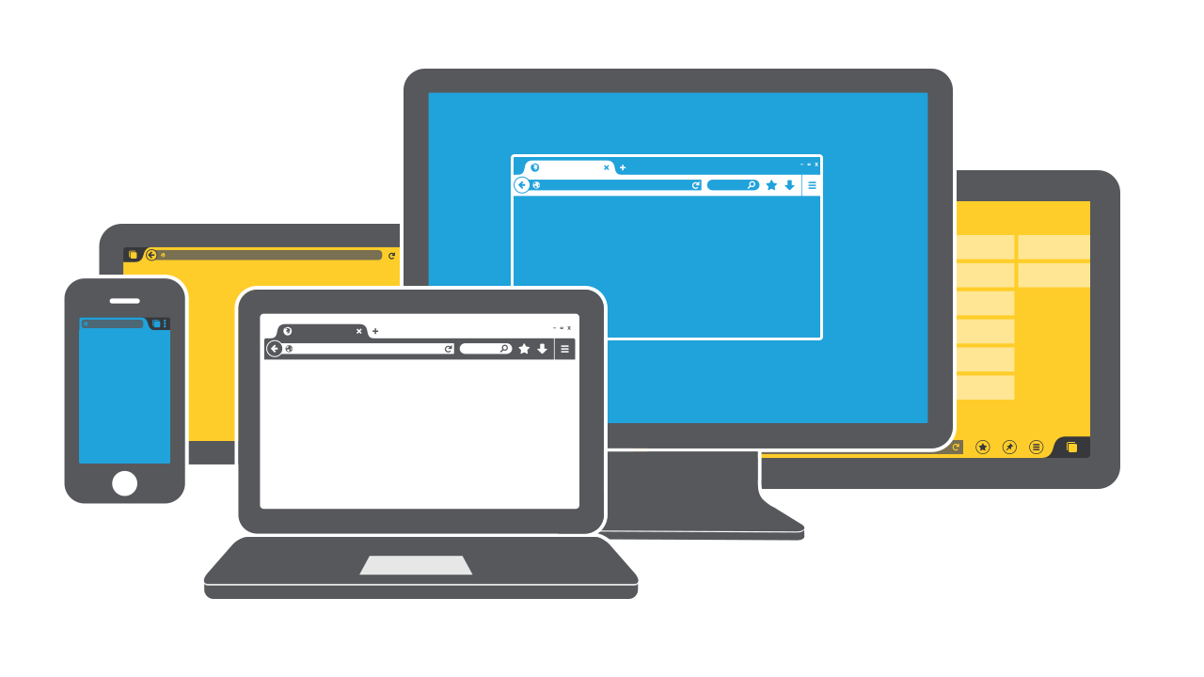
GUI (General User Interface)
Tkinter library is used
Calling the classes from there to put them in use e.g. Labels, Buttons and Entries
Window form is divided by the frames
Every Element is put in their right order working with rows and columns

Slide 6
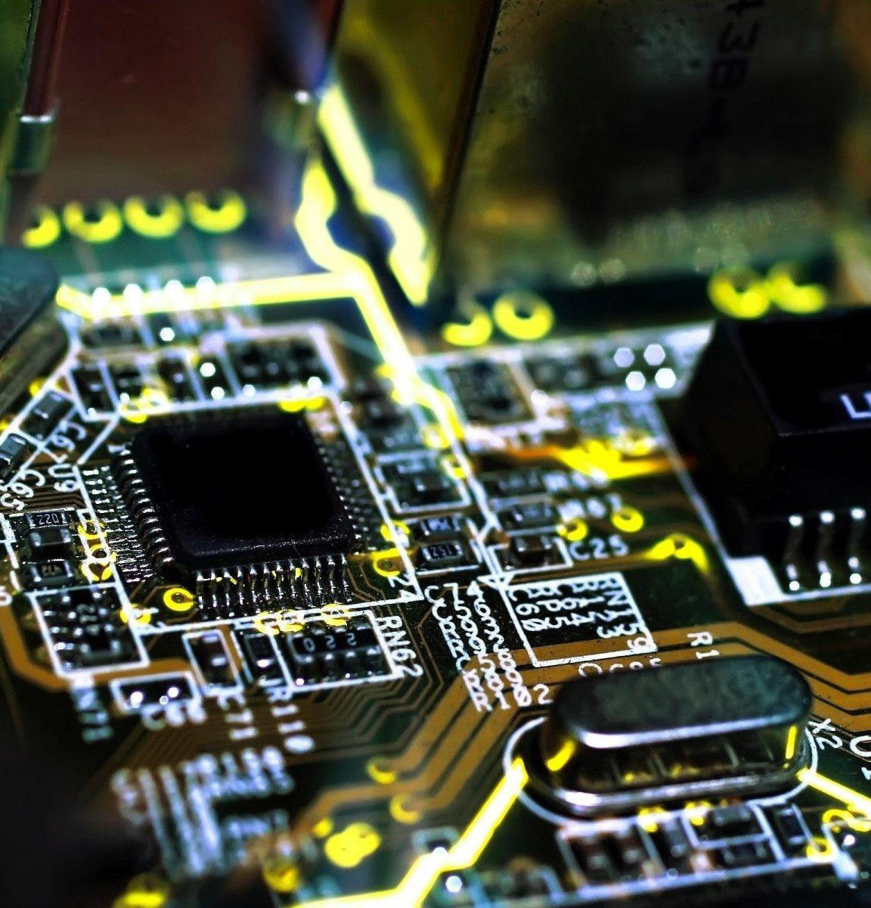
Hardware
Raspberry for Operating Machine
Raspbian for Operating System
Breadboard to connect LEDs
Jumper Wires
Capacitor 1uf
LDR (Light Dependent Resistor) to record the intensity of lights

Slide 7
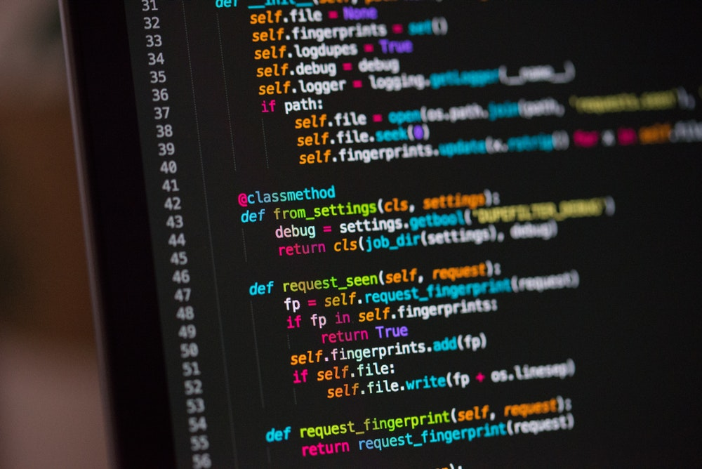
Python For backend Code
Functions are defined and bound with buttons
Buttons are disabled and enabled though functions
Different manipulations are put in action

Slide 8

CONCLUSION
Smart Room System is working as expected. It is now very useful as it has a good capacity to turn light the appliances On and Off through a well maintained GUI. It is now easy to turn On and Off as there is no need to be worried about dealing with hard physical buttons and all.

Slide 9
THANK YOU

